Slide 1
Information Retrieval
Topic- Relevance feedback and query expansion
(Relevance feedback )
Lecture-29
Prepared By
Dr. Rasmita Rautray & Dr. Rasmita Dash
Associate Professor
Dept. of CSE

Slide 2
Relevance feedback

Slide 3
Content
Relevance feedback
Rocchio algorithm

Slide 4
Relevance
We will evaluate the quality of an information retrieval system and, in particular, its ranking algorithm with respect to relevance.
A document is relevant if it gives the user the information she was looking for.
To evaluate relevance, we need an evaluation benchmark with three elements:
A benchmark document collection
A benchmark suite of queries
An assessment of the relevance of each query-document pair

Slide 5
Relevance: query vs. information need
The notion of “relevance to the query” is very problematic.
Information need i : “I am looking for information on whether drinking red wine is more effective at reducing your risk of heart attacks than white wine.”
This is an information need, not a query.
Query q: [RED AND WINE AND WHITE AND WINE AND HEART AND ATTACK]
Consider document d′: He then launched into the heart of his speech and attacked the wine industry lobby for downplaying the role of red and white wine in drunk driving.
d′ is relevant to the query q, but d′ is not relevant to the information need i .
User happiness/satisfaction (i.e., how well our ranking algorithm works) can only be measured by relevance to information needs, not by relevance to queries

Slide 6
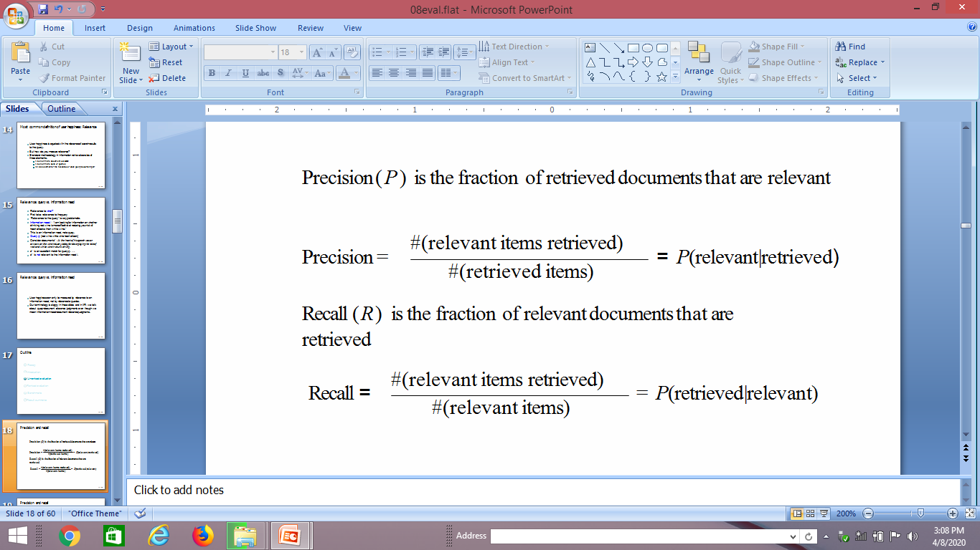
Precision and recall

Slide 7
A combined measure: F
F allows us to trade off precision against recall.
Balanced F:
F = 2PR/ (P + R)
This is a kind of soft minimum of precision and recall.

Slide 8
Interactive relevance feedback: improve initial retrieval results by telling the IR system which docs are relevant / non-relevant.
Best known relevance feedback method: Rocchio feedback
Query expansion: improve retrieval results by adding synonyms / related terms to the query
Sources for related terms: Manual thesauri, automatic thesauri, query logs

Slide 9
How can we improve recall in search?
Main topic today: two ways of improving recall: relevance feedback and query expansion
As an example consider query q: [aircraft] . . .
. . . and document d containing “plane”, but not containing “aircraft”
A simple IR system will not return d for q.
Even if d is the most relevant document for q!
We want to change this:
Return relevant documents even if there is no term match with the (original) query

Slide 10
Recall
Loose definition of recall in this lecture: “increasing the number of relevant documents returned to user”
This may actually decrease recall on some measures, e.g., when expanding “jaguar” to “jaguar AND panthera”
. . .which eliminates some relevant documents, but increases relevant documents returned on top pages

Slide 11
Options for improving recall
Local: Do a “local”, on-demand analysis for a user query
Main local method: relevance feedback
Global: Do a global analysis once (e.g., of collection) to produce thesaurus
Use thesaurus for query expansion

Slide 12
Relevance feedback: Basic idea
The user issues a (short, simple) query.
The search engine returns a set of documents.
User marks some docs as relevant, some as non-relevant.
Search engine computes a new representation of the information need. Hope: better than the initial query.
Search engine runs new query and returns new results.
New results have (hopefully) better recall.
We will use the term ad hoc retrieval to refer to regular retrieval without relevance feedback.

Slide 13
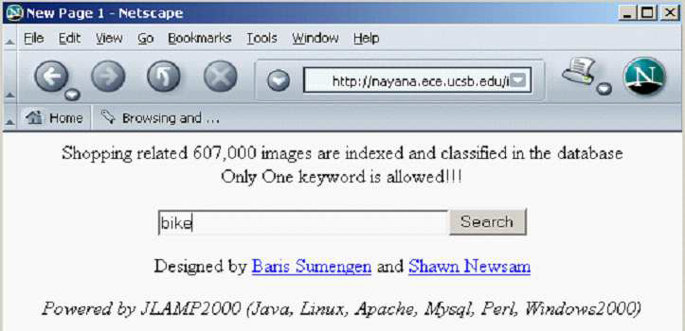
Relevance feedback: Examples

Slide 14
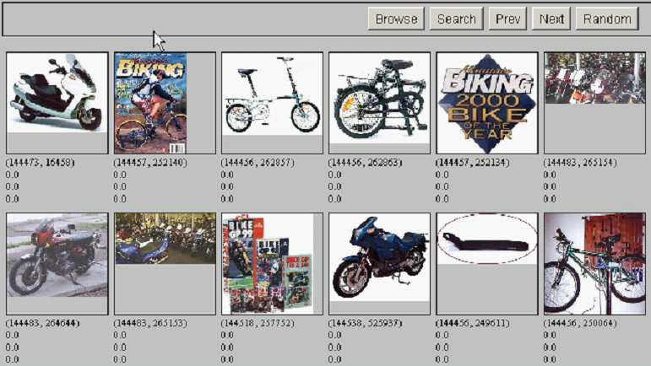
Results for initial query

Slide 15
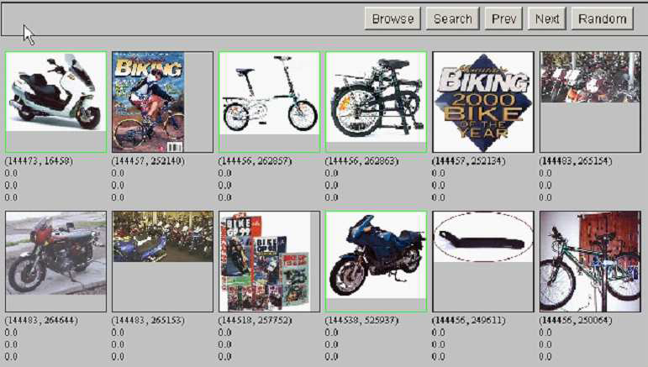
User feedback: Select what is relevant

Slide 16
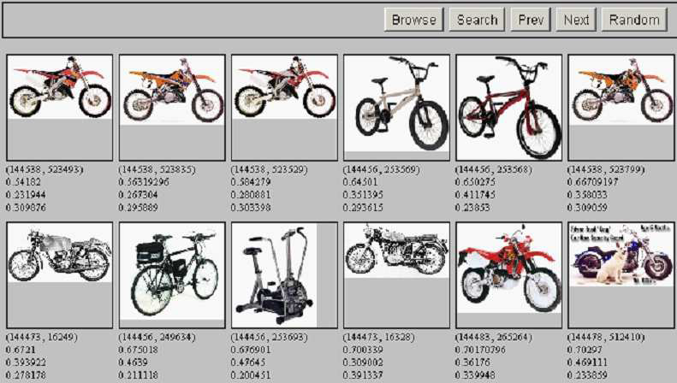
Results after relevance feedback

Slide 17
Key concept for relevance feedback: Centroid
The centroid is the center of mass of a set of points.
Recall that we represent documents as points in a high-dimensional space.
Thus: we can compute centroids of documents.
Definition:
where D is a set of documents and is the vector we use to represent document d.

Slide 18
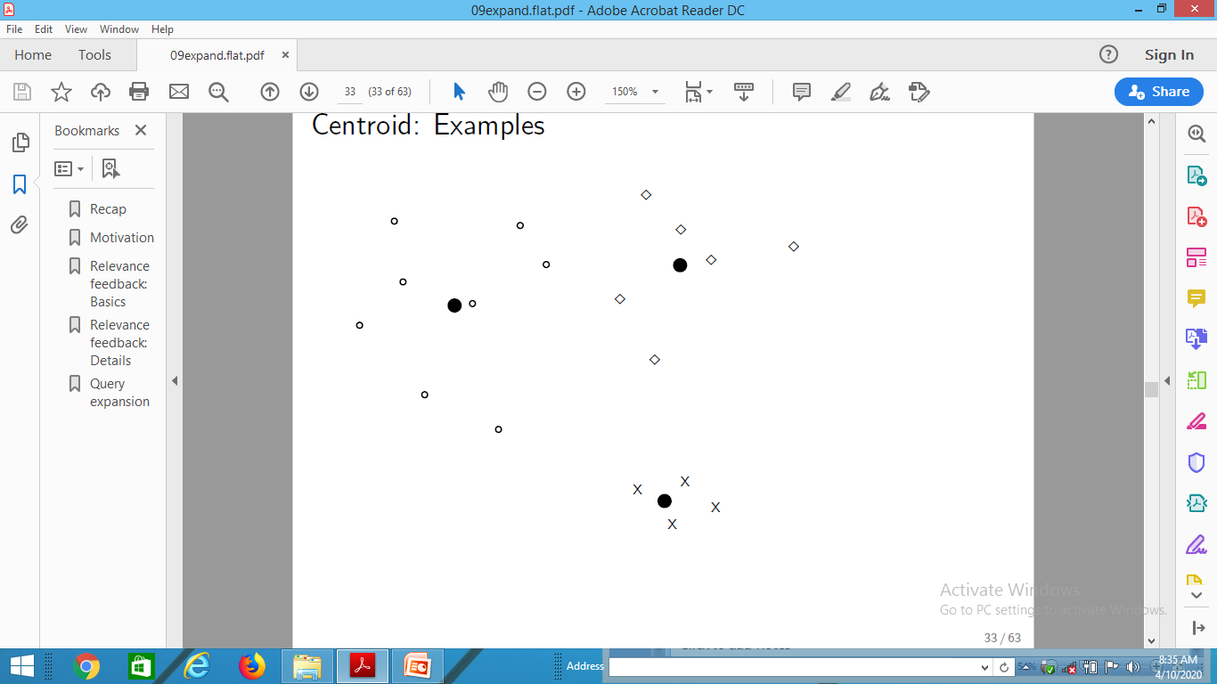
Centroid: Examples

Slide 19
Rocchio algorithm
The Rocchio algorithm implements relevance feedback in the vector space model.
Rocchio chooses the query that maximizes
D_{r} : set of relevant docs; D_{nr} : set of nonrelevant docs
Intent: is the vector that separates relevant and non-relevant docs maximally.
Making some additional assumptions, we can rewrite as:

Slide 20
Rocchio algorithm
The optimal query vector is:
We move the centroid of the relevant documents by the difference between the two centroids.

Slide 21
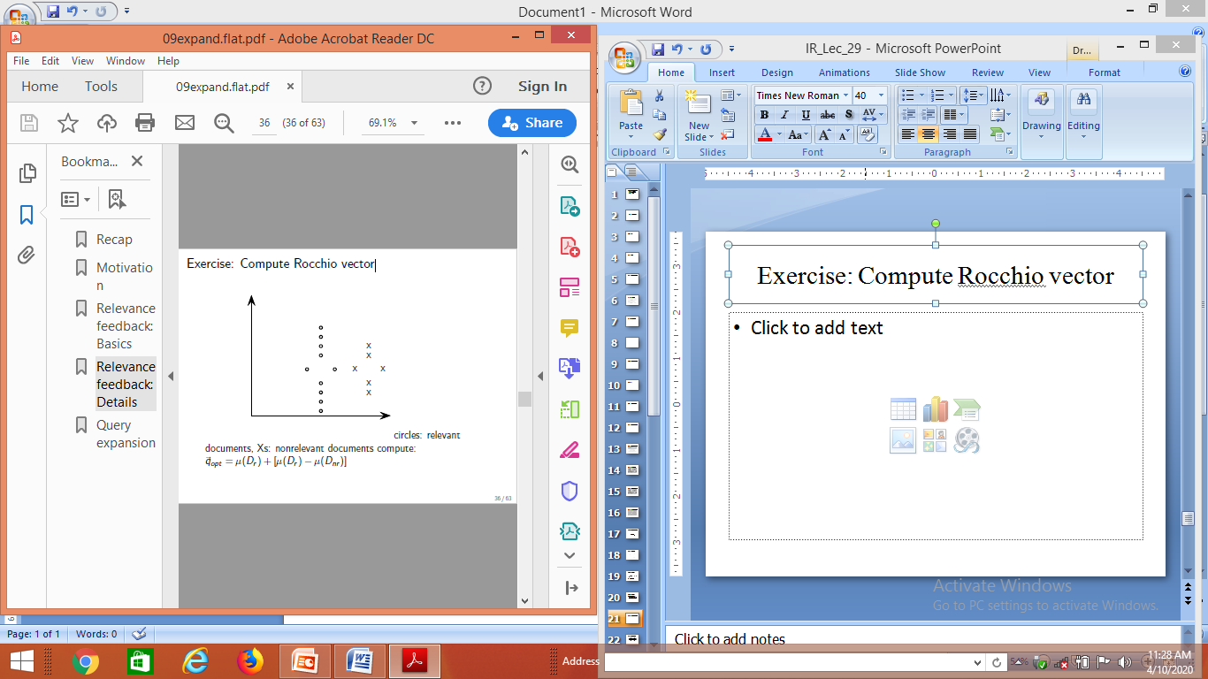
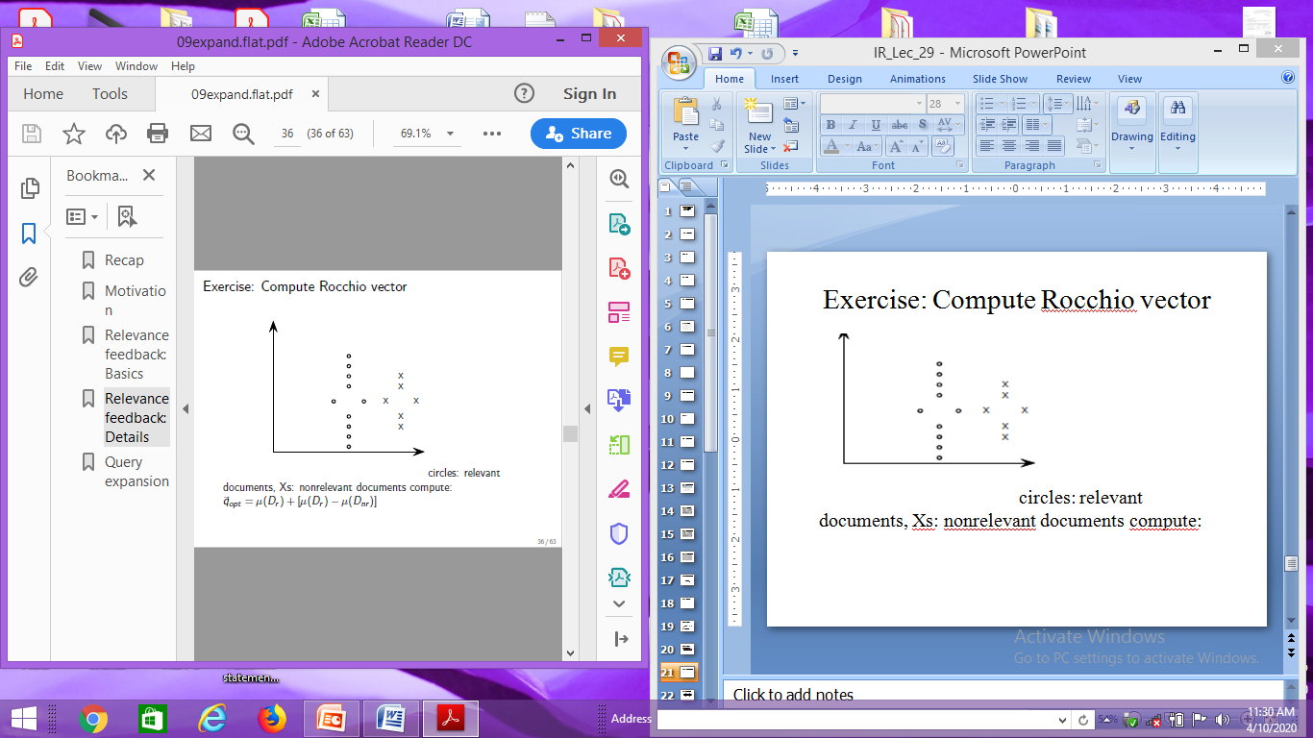
Exercise: Compute Rocchio vector
circles: relevant documents,
Xs: nonrelevant documents
compute:

Slide 22
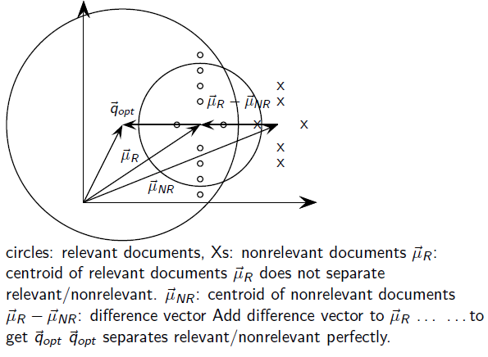
Rocchio illustrated

Slide 23
Thank You

